Slide 1


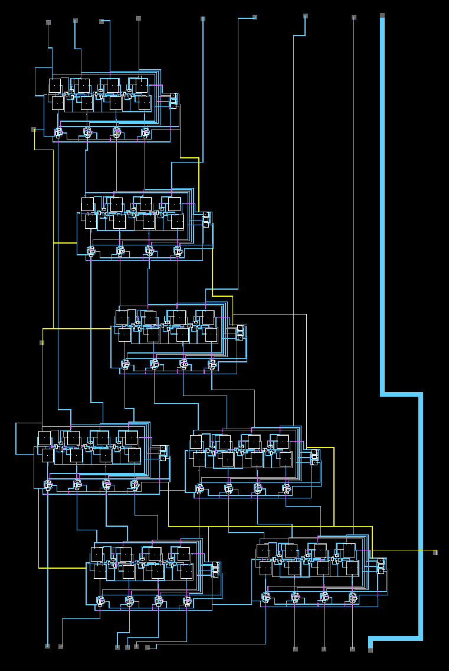
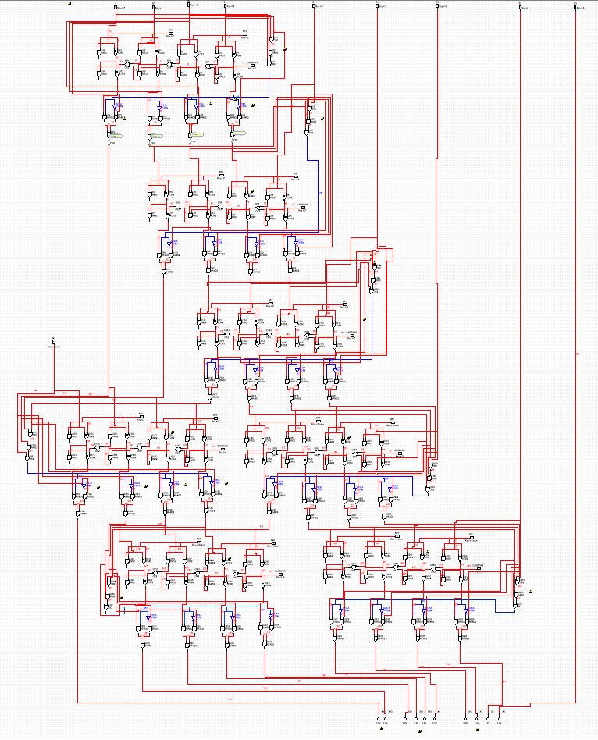
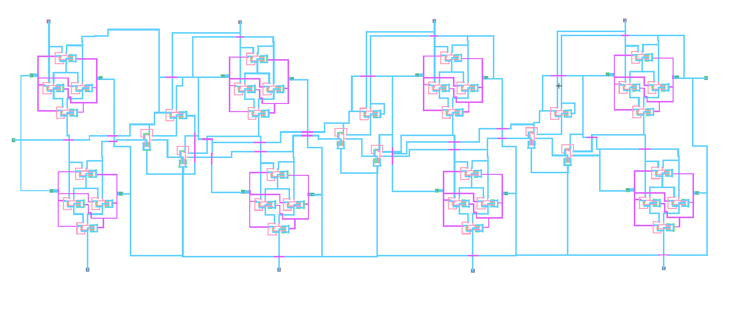
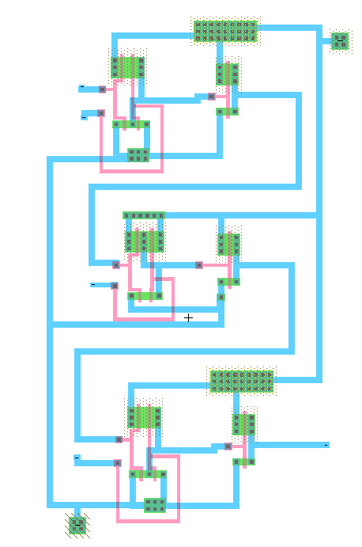
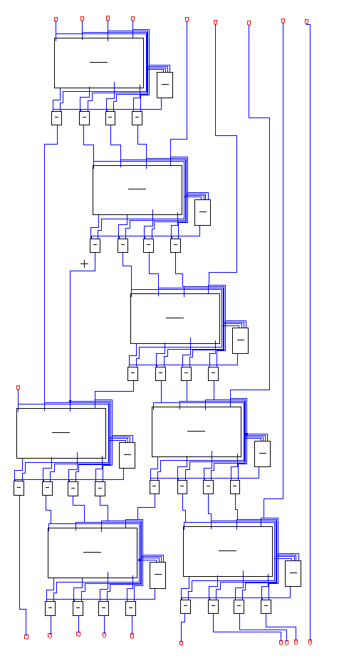
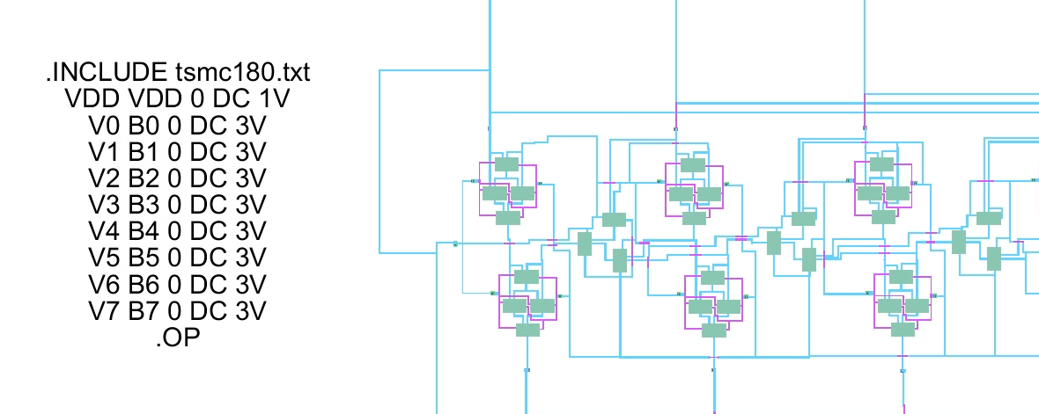
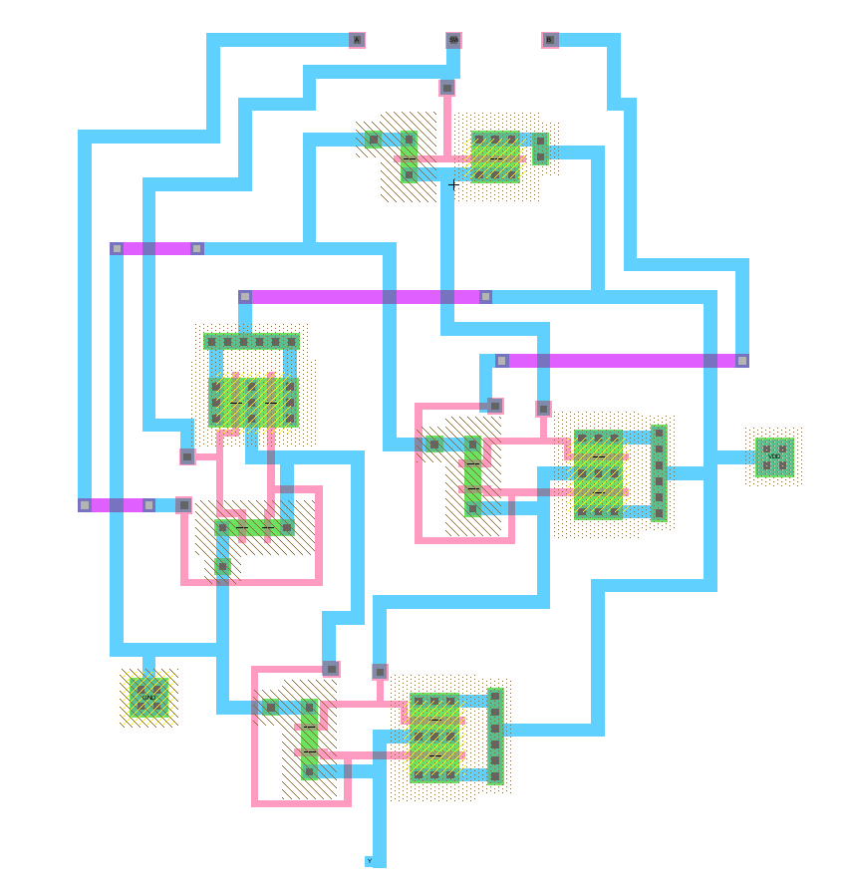
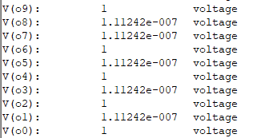
8-bit Double-Dabble Algorithm (Binary to BCD)
Students - Amaan Ahmed, Omer Al Sumeri, Luis Villanueva ECE 140 VLSI Design – Fall 2023 – California State University, Fresno
-LAYOUT-
-DESIGN-
Logic Diagram
4-bit Adder
Logic Explanation
The double dabble algorithm implemented in this project is purely combinational. It works by conditionally adding 3 to sets of 4-bits if the value is greater than 4. The design begins with a conditional adder; the inputs are fixed 0, bit 7, bit 6, bit 5. The conditionally added values are passed down, with three LSBs of the above conditional add and another bit to the right are the inputs for the next conditional add. The sequence continues until the output is reached, inserting another for when there are excess 3 bits + 0 on the previous layer’s output. For each conditional add, there is the 4-bit adder, the comparator, and four 2-1 multiplexers.
This is created with 4 full adders. The full adders consisted of three inputs, the carry-in, A-input, and B-input. The output will then be the sum of the A and B bit and the carryout bit. To do the carryout operation, there are 3 NANDs that use the values from the A, B, Carry-in and Sum. The carry-in for the first adder must be set to zero. For each input bit there needs to be a full adder, the carry-out from the LSB will propagate into the carry-in of the next MSB.
Timing
Unfortunately, Electric VLSI outputs are incorrect—timing included. LTspice timing is outside the scope of this project, so a few working samples from Electric are provided. Most gates are in working condition.
The logic diagram was the first design attempted. This is the final design of two prototypes; one included a clock and D-Flip Flops to create a feedback loop after shifting and/or adding. That design and its timing were cut due to difficulties in simulation. A combinational design of the algorithm is the one implemented instead.
Comparator
 | NAND
2-bit input | Time to Logic | Logic
00 | 9.894 ns | 1
10 | 10.247 ns | 1
01 | 10.247 ns | 1
11 | 19.784 ns | 0
 | INV
1-bit input | Time to Logic | Logic
1 | 9.894 ns | 0
0 | 9.894 ns | 1
 | AND
2-bit input | Time to Logic | Logic
00 | 20 ns | 0
01 | 20 ns | 0
10 | 20 ns | 0
11 | 30 ns | 1
Schematic
 | XOR
2-bit input | Time to Logic | Logic
00 | 19.788 ns | 0
10 | 29.965 ns | 1
01 | 19.717 ns | 1
11 | 39.929 ns | 0
 | OR
2-bit input | Time to Logic | Logic
00 | 29.682 ns | 0
10 | 19.788 ns | 1
01 | 19.788 ns | 1
11 | 19.717 ns | 1
A comparator was connected to each of the adders.
It checks to see if the 4-bit value input is greater than 4.
This is the timing simulation for all the lower gates used.
If the 4-bit input value is greater than 4, then the output is 1. The cell is comprised of two OR cells and one AND cell (which is INV+NAND). The propagated output of the OR gate signals if the 4-bit value is greater than four. This controls whether +3 or +0 on the mux.
Simulation
Multiplexer
LTspice was required for simulation as Electric VLSI consistently gave incorrect outputs above the addition and XOR levels.
-ABSTRACT-
The 2 to 1 Multiplexer cell is constructed using three NAND cells and one inverter cell. The input for the inverter is the selector signal from the comparators.
The double-dabble algorithm is used to convert an 8-bit binary input into a 10-bit binary-coded-decimal (BCD). The algorithm typically works by adding three to 4-bit decimal sections of the running BCD output when any decimal is greater than 4; the input is then shifted in once, shifting up to a total of n-bit times. However, this implementation of the double dabble algorithm was mathematically optimized for a combinational calculation, without the need for timing or other error-prone systems. The bits propagate through a series of comparators, adders, and multiplexers to arrive at a correct BCD output. This system was theorized in Multisim, built in Electric VLSI, and simulated in LTspice.
The schematic was created after gates were completed in schematic, which was after theorizing our design in Multisim. This simulation gives the same outputs as the layout. Arriving to this stage proved the most difficult of all steps, as it was discovered that Electric VLSI gave incorrect outputs for even one level of conditional addition.
The selector signal is passed into the inverter. The inverted selector signal is passed into the first NAND with input A and the non inverted selector signal is passed into the second NAND with input B. Both outputs of the NANDs then passed into a final NAND which gives the output. If the selector signal is 1, then input B is passed. If the selector signal is 0, then input A is passed.
An example input given was 3V set to all bits, which is 1111_1111 (255 dec.). The output is here, which shows that it is 10_0101_0101 (which 2_5_5).
Sources used: https://en.wikipedia.org/wiki/Double_dabble https://github.com/AmeerAbdelhadi/Binary-to-BCD-Converter

